Slide 1
Machine Learning & Public Policy Lecture 3: Anomaly Detection & Surveillance Systems
Professor Edward McFowland III
Information Systems and Decision Sciences
Carlson School of Managment
University of Minnesota
Notes:
ML helps structured unstructured data. We saw images yesterday, we can also use text.
LDA
Word to Vec
Twitter Data
Google Trends

Slide 2
Prediction For Policy
Observation 1: Sometimes correlation is valuable on its own

Slide 3
Anomaly Detection
Observation 1I: Sometimes goal is one of detection or discovery
Notes:
One thing we learned from the previous lecture and example in education is that text can be a valuable source of (unstructured) data. How were we able to structure it? What if we do not have known structures or labeled data to map things to?

Slide 4
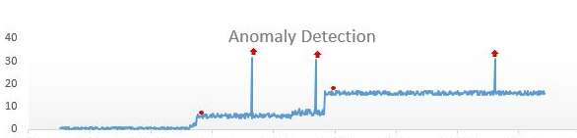
Anomaly Detection Paradigm
Identifying when a “system” deviates away from its expected behavior.
Notes:
They system can be as physical as the subsystem that controls the engine on air plane
Or behavioral as the one which controls the purchasing behavior of utility maximizing agents given their social network.

Slide 5
Anomaly Detection
What are anomalies/outliers?
The set of data points that are considerably different than the remainder of the data (anomalies are generated by a “different mechanism”)
Interesting issue: anomaly detection vs. outlier detection
Variations of anomaly/outlier detection problems
Given dataset D, find all data points x∈D with anomaly scores f(x) greater than some threshold t
Given dataset D, find all data points x∈D having the top-n largest anomaly scores f(x)
Given dataset D, containing mostly normal (but unlabeled) data points and test point x, compute anomaly score f(x) with respect to D
Notes:
What is anomaly detection
What are some ways in which we can use it
Credit card fraud detection, telecommunication fraud detection, health care fraud
Data points, records, instances that are considerably different from the rest of the data (or the expectation)
Expectation can come from other data points, so different can be measure in distance
Working assumption is that the majority of data is normal, and trying to find deviations away from that.
Outlier detection, to me, is simply something that happens by random chance where as an outlier is produced by a different process
You are target and you are monitoring how often people show up everyday
On 1st Wednesday of the month you see spike (10x). 1st time it may be an outlier, but if you notice it happens second month, 3rd month. This is no longer an oulier but an anomalous pattern.
Pizza hut next door has cheap pizzas on Wednesdays. You can take advantage of that and say, maybe I should sell pizza a target? Maybe I come up with an agreement with Pizza Hut where we have Sales on Pizza and then Sales at Target
If you can identify the anomlous pattern, you can understand it, and turn the knobs in your favor but outliers do not give you knobs to turn.
Anomaly could be incorrect data
Could be data quality issues
For example data entry error
Filling out online form (supposed to put age but put years of birth).
Would be large value of birth, detection method would find it.
Could be regular correct data but just abnormal
Removing outliers or not depends on context
If it is a data error may want to remove or fix it.
If it is a true correct value it may make sense to keep it in.
Could be indicative of interesting finding.
There are many tasks where the goal is to identify this unexpected things, we know how to handle when data is going well.
When are the things I expected to see not happening, because something has changed or potentially my assumptions are wrong, so I wanted to detect that and use it.
Blinding preprocessing outliers may rob you of unexpected/interesting findings.
Anomaly detection is a powerful paradigm, whenever you want to know when things are going they way you expected, then you have an anomaly detection question.
A lot of modeling is capturing what is expected or normal, anomaly detection is the opposite.

Slide 6
Anomaly Detection
Main goal: focus the user’s attention on a potentially relevant subset of the data.
Automatically detect relevant individual records, or groups of records.
Characterize and explain patterns: pattern type, affected subset, models of normal/abnormal data.
Present the pattern to the user.
Some common detection tasks
Detecting anomalous records or groups
Discovering novelties (e.g. new drugs)
Detecting clusters in space or time
Removing noise or errors in data
Detecting specific patterns (e.g. fraud)
Detecting emerging events which may require rapid responses.

Slide 7
Examples
Given a massive database of financial data, which transactions are suspicious and likely to be fraudulent?
Given the huge number of container shipments arriving at our country’s ports every day, which should be opened by customs (to prevent smuggling, terrorism, etc.)?
Given a log of all the traffic on our computer network, which sessions represent (attempted) intrusions?
Notes:
What is anomaly detection
What are some ways in which we can use it
Credit card fraud detection, telecommunication fraud detection, health care fraud
Data points, records, instances that are considerably different from the rest of the data (or the expectation)
Expectation can come from other data points, so different can be measure in distance
Working assumption is that the majority of data is normal, and trying to find deviations away from that.
Outlier detection, to me, is simply something that happens by random chance where as an outlier is produced by a different process
You are target and you are monitoring how often people show up everyday
On 1st Wednesday of the month you see spike (10x). 1st time it may be an outlier, but if you notice it happens second month, 3rd month. This is no longer an oulier but an anomalous pattern.
Pizza hut next door has cheap pizzas on Wednesdays. You can take advantage of that and say, maybe I should sell pizza a target? Maybe I come up with an agreement with Pizza Hut where we have Sales on Pizza and then Sales at Target
If you can identify the anomlous pattern, you can understand it, and turn the knobs in your favor but outliers do not give you knobs to turn.
Anomaly could be incorrect data
Could be data quality issues
For example data entry error
Filling out online form (supposed to put age but put years of birth).
Would be large value of birth, detection method would find it.
Could be regular correct data but just abnormal
Removing outliers or not depends on context
If it is a data error may want to remove or fix it.
If it is a true correct value it may make sense to keep it in.
Could be indicative of interesting finding.
There are many tasks where the goal is to identify this unexpected things, we know how to handle when data is going well.
When are the things I expected to see not happening, because something has changed or potentially my assumptions are wrong, so I wanted to detect that and use it.
Blinding preprocessing outliers may rob you of unexpected/interesting findings.
Anomaly detection is a powerful paradigm, whenever you want to know when things are going they way you expected, then you have an anomaly detection question.
A lot of modeling is capturing what is expected or normal, anomaly detection is the opposite.

Slide 8
Anomaly Detection
Challenges
How many outliers are there in the data?
Method is unsupervised
Validation can be quite challenging
Finding needle in a haystack
Working assumption:
There are considerably more “normal” observations than “abnormal” observations (outliers/anomalies) in the data
Notes:
It is unsupervised learning technique--in most cases--like many of the other methods we have covered in this class
like we do not know how many clusters there are, we do not know how many outliers there are
Validation is hard because we do not know if our method is correct
There are a set of tools people use for variety of different purposes
Many different approaches and techniques use to identify outliers.
You have to decide as a domain expert to determine which is appropriate.
Seeing increase in 10 when the context is cutomers at target is not anomalous but when it is degree temperature of an engine it is a huge anomaly
Working assumptions is that vast majority is normal.
Trust what you see in majority of data.
Baseline over which to calculate normality.

Slide 9
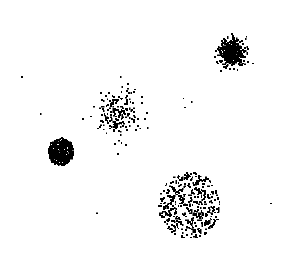
Anomaly Detection
General Steps
Build a profile of the “normal” behavior
I.e., patterns or summary statistics for the overall population
Use the “normal” profile to detect anomalies
I.e., observations whose characteristics differ significantly from the normal profile
Detection schemes
Graphical
Distance/proximity - based
Statistical/model-based
Notes:
As long as you can understand or define normal behavior, you can identify anomalies.
As example, using statistical description, like a normal distribution with mean and std
if you see something 5std away from mean -> highly unlikely
This is highly oversimplified, but in clusters, you may have few data points that do not fit into any cluster.
We could have a long course on this topic, variety of techniques with sophisticated math behind them.
I have made my careers on this.
3 main approaches: Graphical, Distance based, Statistical Model based

Slide 10
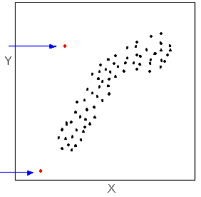
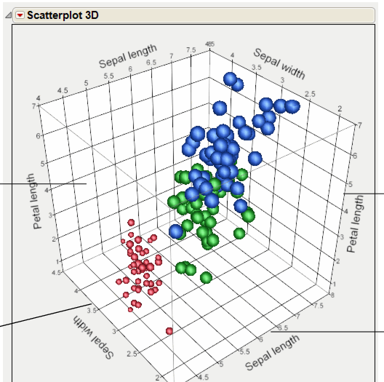
Graphical Approaches: Examples
Scatter Plot
3d Scatterplot
Notes:
Scatter plot is one of the more effective ways, because right away you can see points that do not follow the group
You can have millions of data points, but right away can see outliers.
In 3-Dims, you can rotate around axis, and see what sticks out.
Up to 3 dims you can do graphical stuff easily

Slide 11
Density Based Anomaly Detection
Observation 1I: Sometimes goal is one of detection or discovery
Notes:
One thing we learned from the previous lecture and example in education is that text can be a valuable source of (unstructured) data. How were we able to structure it? What if we do not have known structures or labeled data to map things to?

Slide 12
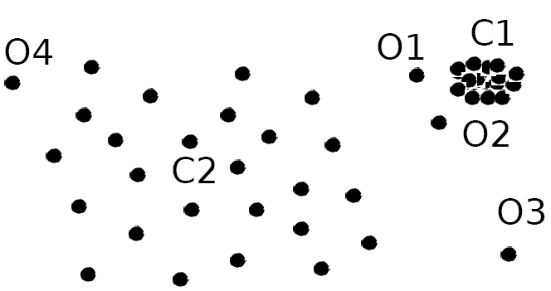
Density-Based Approach
Finds local outliers, i.e., by comparing data points to their local neighborhoods, instead of looking at the global data distribution
Intuition: The density around an outlier object is significantly different from the density around its neighbors
Method: Use the relative density of an object against its neighbors as the indicator of the degree of the object being outliers
Example: O1 and O2 are local outliers (to C1), O3 is a global outlier, but O4 is not an outlier. Nearest-neighbor-based approaches would not identify O1 and O2 as outlier (as opposed to O4).
Notes:
Slightly more sophisticated way to use distance as part of the calculation.
Imagine this simple pic.
If you just used k-nearest neighbor approach. Which would be biggest outliers
Maybe 03 then 04, then everything is close to everything else.
Look at 01 and 02, while in absolute distance they are not that far from the cluster c1.
This cluster is very dense.
So now if you compare 02 to any point in c1, all these points are extremely near other points while 02 is not.
So if you take in consideration the density of the points what is anomaly may change.’
So like in my target example and arrivals, variation is high so distance needs to be larger to signal an anomlay but in my engine temperature case is the opposite
If we look at c2, o4 is actually not that different than the other points in c2.
It is a little bit further away, if you look at the neighborhood of each data point looks similar.
So ideas is another way to look at outlier is to look at density.
And if the your density (of your local neighborhood) is very different than that of other points, then it could be flagged as an outlier.

Slide 13
Density-Based Approach: Local Outlier Factor (LOF)
Basic idea:
For each object (data point), compute the density of its local neighborhood (defined by the k nearest neighbors)
Compute local outlier factor (LOF) of a given object as the ratio between its local density and the local densities of its nearest neighbors
Outliers are objects with largest LOF value
A number of further variations and refinements have been proposed
Notes:
Fairly well known approach, LOF based on density idea.
You want to compare some measure of local density of each ppint.
Take densities from a point to it's k nearest neighbors.
If you take the inverse of distances you get densitiy
Function that gives you a numeric score of how outlier ish you are,
which is a ratio of your density and those of your nearest neighboors.
LOF = 1, means you are no different than your neighbors, you are similar to your surround data points neigherboods
Very far away from 1, from one means your neigheboorhood looks different than surrounding data
Many variations of this have been proposed in the literature

Slide 14
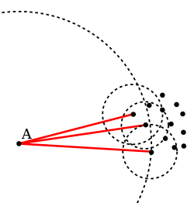
LOF Approach: Example
Object A has much lower local density than its nearest neighbors
Source: wikipedia.org
Notes:
- A has to go very far to capture it neighborhood while its neighbors do not

Slide 15
LOF Approach: Details
k-distance of object A, dist_{k}(A)
Distance between A and its k^{th} nearest neighbor
k-distance neighborhood of A, N_{k}(A)
N_{k}(A) = {B | B∈D, dist(A,B)≤dist_{k}(A)}
Esentially, N_{k}(A) is the set of k nearest neighbors of A
However, technically size of N_{k}(A) could be bigger than k since multiple objects may have identical distance to A
Reachability distance of A from B: reachdist_{k}(A,B)
reachdist_{k}(A,B) = max { dist_{k}(B), dist(A,B) }
I.e., objects A that belong to the k nearest neighbors of B have the same reachdist_{k}(A,B)

Slide 16

LOF Approach: Details (2)
Local reachability density of A, lrd(A)
lrd(A) = 1 / ( ∑_{B∈Nk(A)} reachdist_{k}(A,B) / |N_{k}(A)| )
I.e., captures how A can be reached from its neighbors
Local outlier factor of A, LOF_{k}(A)
I.e., average local reachability density of A’s neighbors divided by the A’s own local reachability density
Notes:
I measure reacbility density to all my points in my neighborhoos
I measure all my neighbors’s reeacbility to their neighrboors.
I take the average of ratio of my distance to theirs

Slide 17
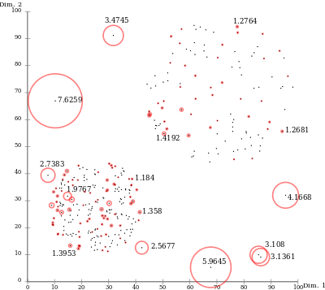
LOF Approach: Example (2)
LOF(x) = 1: data point x is comparable to its neighbors (not an outlier)
LOF(x) < 1 indicates a denser region
LOF(x) significantly larger than 1 indicate outliers
Source: wikipedia.org
Notes:
-7.6 is very far evreythings
1.2 is far away from points but they are themsleves far spread out.

Slide 18
Model Based Anomaly Detection
Observation 1I: Sometimes goal is one of detection or discovery
Notes:
One thing we learned from the previous lecture and example in education is that text can be a valuable source of (unstructured) data. How were we able to structure it? What if we do not have known structures or labeled data to map things to?

Slide 19
Statistical Approaches
Statistical methods (also known as model-based methods) assume that the regular data follow some statistical model (a stochastic model)
The data not following the model are outliers
Lots of different models are available
Effectiveness of statistical methods highly depends on whether the assumption of statistical model holds in the real data
Many statistical techniques have been developed
E.g., parametric vs. non-parametric
Notes:
So now statistical methods is lightly more sophisticated approach.
Not just letting person identify visual but also try to quantify outliers a little bit.
Many these approaches work on low dim data.
Assume there is a model generating the data. If you take heights in Carlson school it will follow normal dist,
If someone's height is 7 std above the mean, that is indicative of something unlikely according to model.
If I trust my model I can ask it the question of how likely my data is, and it may say all this points are likely, but these 3 over here are not.
How good the approach is, depends on how well the model assumptions fits what is happening in reality.
Sometimes they match really well, and sometimes it is very different
This is a place where Bayesian Networks can be extremely handy!

Slide 20
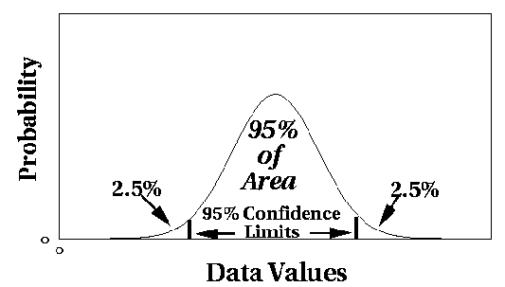
Statistical Approaches: General Idea
Assume a parametric model describing the distribution of regular data (e.g., normal distribution)
Apply some statistical test/procedure on how likely is that a given data point was generated by the assumed distribution
Notes:
IQR is based on Norm assumptions.
More generally people have come up with approaches that assume specific parametric model that characterize normal behavior.
You can then do outlier detection, as a statistical test.
This is crucial because test give us statistical guarantees
I can test the probability that my data was drawn from this distribution (i.e. is expected)
You can look is the data (what ever dist is the best fit) is your data point(s) fall within 95% confidence limit.
For normal distribution do something like this.
In 1 or 2 dims it is easier
you can think of a 2 dim Gaussian bell and seeing how likely it is
For 50 dims it may be harder to learn or write out 50 dim distribution

Slide 21
Non-Parametric Methods for Anomaly Detection
Non-parametric: The model of regular data is learned from the input data without any a priori structure
Fewer assumptions about the data – applicable in more scenarios
Example:
Histogram-based approach
Notes:
In some cases the distribution may not be known.
Very simple methods people use as a quick check of data: Histograms
In exploratory analysis don't just start throwing the most complicated tools you have at your data.
You have to internalize and understand
I have all these variable, what does they look like.
Is it skewed, is it normal, is it uniform.
Look at histogram to see how data is distributed
to understand see if there is a parametric model you can learn
or to know there is not, and use your histogram directly as you non-parametric model.

Slide 22
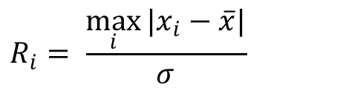


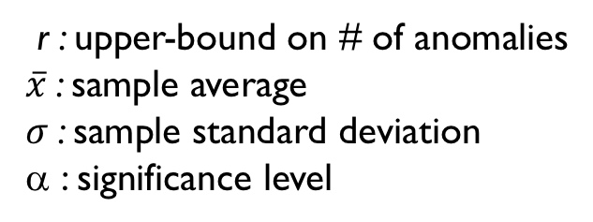
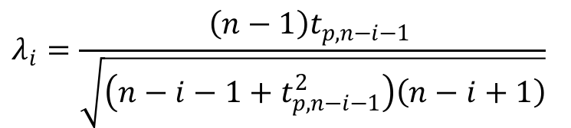
Generalized Extreme Studentized Deviate
r : upper-bound on # of anomalies
$\overline{x}$: sample average
$σ$: sample standard deviation
α : significance level
H₀: There are no anomalies in the data
H_{a}: There are up to r anomalies in the data
$$λ_{i}=\frac{\left(n−1\right)t_{p,n−i−1} }{\sqrt{\left(n−i−1+t_{p,n−i−1}^{2}\right)\left(n−i+1\right)}}$$
$$R_{i}= \frac{\max_{i}{{|x}_{i}−\overline{x}|}}{σ}$$
Remove the observation i and recompute. Repeat until r observations have been removed, result in the r test statistics R₁, R₂, ..., R_{r}.
$$P\left(∪_{i}\{R_{i}≥λ_{i}\}\right)≤α$$
Select largest i such that $R_{i}>λ_{i}$
Assumes Gaussian Distribution
Seasonality unaware
Notes:
r can be percentage of data, no more than 5% of data is anomalies
We conducted a statistical test and we get all the gaurantes
R_i is are statistic lambda is our critical value
What you want from any test that the number of times you reject under the null is alpha
Prob reject R_1 or R_2 or … R_r is bounded by alpha
Take the largest value of R_i that you rejected
The more test you run the more extreme the value has to be to be significant.
If things are a time series then seasonally unaware
Which can be a problem in timer series or spatial data

Slide 23
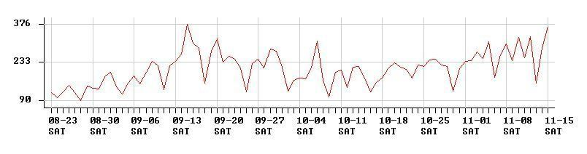
Spatial and temporal anomaly detection
A simple model-based anomaly detection when we monitor a single real-valued quantity over time and/or space.
Report any observed value that is significantly above or below its expected value (e.g., using GESD).
Time series data
Spatially distributed data
1.2
1.3
2.0
1.8
0.03
1.0
0.7
1.3
0.9
1.7
Notes:
Imagine you are Target and you have a bunch of stores throughout space and you have number of people coming into your stores
You want to do anomaly detection to see if there is a given store, set of stores or region, where people coming in is really high or low (high or low preforming)
This data is not guassian
We can moving window
Smoothing
For a given data point I can go back 5 days and make prediction for tomorrow.
Equivalents to use nearest neighbors in the past
When I expectation based on moving average and what I actually observe, and the difference is a residual.
When residual too high I may raise a red flag

Slide 24
Spatial and temporal anomaly detection
A simple model-based anomaly detection when we monitor a single real-valued quantity over time and/or space.
Report any observed value that is significantly above or below its expected value (e.g., using GESD).
Time series data
Spatially distributed data
1.2
1.3
2.0
1.8
0.03
1.0
0.7
1.3
0.9
1.7
Notes:
We can actually do test though because I have residuals.
Like we do with regression and we assume our error is normal 0 with some variance
I could write my regression that autoregressive
- Show them a basic regression, then Y = f(X), then Y = f(Y_t-1, yY_t-2)
- My aexpecation for today is just some average over what I rpevious saw pluse noise
Now that we have x bar (either nearest neightbors or weighted average) we now can
Write on board Given that you have xi – E[xt], xi – bar x, gets you the residuals
You can imagine that you have spatio temporal data. Where at every space location there is a time series.
We can use GSED to tell me which data points are outliers
We started with GSED, with assumptions, we then transformed our data to remove the trends/seasonality
At each target store, you have of a time series of # customers. You want to notice if any regions are doing particularly poor or well. You can even imagine that you have multiple time series: # of purchases of different types of products (produce, houewares, electronics).s

Slide 25
Spatial and temporal anomaly detection
A simple model-based anomaly detection when we monitor a single real-valued quantity over time and/or space.
Report any observed value that is significantly above or below its expected value (e.g., using GESD).
Time series data
Spatially distributed data
1.2
1.3
2.0
1.8
0.03
1.0
0.7
1.3
0.9
1.7
Time series analysis: the expected value for time step t is a function of the values for time steps 1 through t – 1.
Spatial regression: the expected value for location s is a function of the values for all other locations.
Exponentially weighted averaging:
E[x_{t}] = (Σ w_{i}x_{i}) / (Σ w_{i}), w_{i} = e^{-(t-i)/b}
where i = 1… t – 1.
Kernel regression, exponential kernel:
E[x_{s}] = (Σ w_{i}x_{i}) / (Σ w_{i}), w_{i} = e^{-d(s, i)/b}
where i ≠ s and d is Euclidean distance.
Notes:
We can actually do test though because I have residuals.
Like we do with regression and we assume our error is normal 0 with some variance
I could write my regression that autoregressive
- Show them a basic regression, then Y = f(X), then Y = f(Y_t-1, yY_t-2)
- My aexpecation for today is just some average over what I rpevious saw pluse noise
Now that we have x bar (either nearest neightbors or weighted average) we now can
Write on board Given that you have xi – E[xt], xi – bar x, gets you the residuals
You can imagine that you have spatio temporal data. Where at every space location there is a time series.
We can use GSED to tell me which data points are outliers
We started with GSED, with assumptions, we then transformed our data to remove the trends/seasonality
At each target store, you have of a time series of # customers. You want to notice if any regions are doing particularly poor or well. You can even imagine that you have multiple time series: # of purchases of different types of products (produce, houewares, electronics).s

Slide 26
Anomalous pattern Detection
Observation 1I: Sometimes goal is one of detection or discovery
Notes:
One thing we learned from the previous lecture and example in education is that text can be a valuable source of (unstructured) data. How were we able to structure it? What if we do not have known structures or labeled data to map things to?

Slide 27
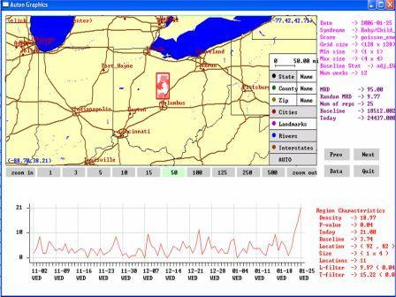
Anomalous pattern detection
Main goal of pattern detection: to identify and characterize relevant subsets of a massive dataset, i.e. groups of records that differ from the rest of the data in an interesting way.
Question 1: Are any relevant patterns present in the data, or is the entire dataset “normal”?
Question 2: If there are any patterns, identify the pattern type and the affected subset of data records for each.
Example: outbreak detection
Are there any emerging outbreak on Twitter? If so, what type of outbreak, and what areas are affected?
Example: financial analysis
Can we deduce the membership and structure of money laundering ring based on known links between suspected individuals?
Notes:
This is the area I work in and it is all about finding collections of anomalies
If you remember our example from last week where we talked about fraud, and how if I am an intelligent fraduster I will buy groceries and gas, then it will be hard to detect becase no invidual transaction looks weird. However, the collection of transactions all that are a little weird will raise the red flag
Same idea in Target
Question 1 is is my entire data weird or are there anomalies
Is there fraud
Question 2 if thee are patterns where are there.
Which transactiona are fraud
Target monitoring twiiter
Is Target a trending topi
Money Laundering
Detecting a network our idnviduals/firms that buy and sell to clear up money
This is still focused on individual record anomalies, what if we want to find patterns (collections of data) of anomalies.

Slide 28
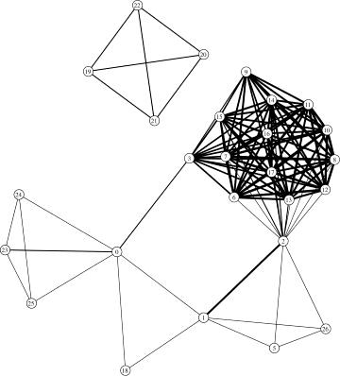
Anomalous pattern detection
Main goal of pattern detection: to identify and characterize relevant subsets of a massive dataset, i.e. groups of records that differ from the rest of the data in an interesting way.
What makes a group of records “relevant”?
Group detection: given a financial network, find highly connected sets of individuals.
1. Matching some known pattern or structure.
Many efficient algorithms have been developed to find dense subgraphs or other structures in network data.
Notes:
- We know that laundering rings are highly dense within the ring and highly sparse outside of the group. So finding such structure

Slide 29
Anomalous pattern detection
Main goal of pattern detection: to identify and characterize relevant subsets of a massive dataset, i.e. groups of records that differ from the rest of the data in an interesting way.
What makes a group of records “relevant”?
Fraud detection: look for individuals with a history of suspicious transactions.
1. Matching some known pattern or structure.
Network intrusion detection: look for suspicious combinations of activities (e.g. port scanning).
2. Multiple related records that are individually anomalous.
In these domains, multiple “slightly anomalous” behaviors may together provide evidence of a major deviation from normal.
Notes:
- Gas Groceries are not anoamlous. However, Gas 3 times for more than you typically purhcase is.

Slide 30
Anomalous pattern detection
Main goal of pattern detection: to identify and characterize relevant subsets of a massive dataset, i.e. groups of records that differ from the rest of the data in an interesting way.
What makes a group of records “relevant”?
Cluster detection: find spatial areas or periods of time with more records than expected.
1. Matching some known pattern or structure.
Event detection: is the recent data differently distributed than the past?
2. Multiple related records that are individually anomalous.
3. Higher (or lower) than expected number of records with some combination of attributes.
Key concept: A group of records may be highly anomalous or interesting even if none of the individual records is itself anomalous.
4. Change in data distribution as compared to the rest of the dataset.
Notes:
Clustering time intervals or locations
My example about pizza on target on Wed
Individual do not look different on their own, but the group is collectively anomalous

Slide 31
Subset scanning
We can scan over subsets of the dataset in order to find those groups of records that correspond to a pattern.
Step 1: Compute score F(S, P) for each subset S = {x_{i}} and for each pattern type P, where higher score means more likely to be a pattern.
Step 2: Consider the highest scoring potential patterns (S, P) and decide whether each actually represents a pattern.
There are many options for computing the score of a subset S.
Notes:
Find the right subset

Slide 32
What’s Strange About Recent Events?
We can scan over subsets of the dataset in order to find those groups of records that correspond to a pattern.
Step 1: Compute score F(S, P) for each subset S = {x_{i}} and for each pattern type P, where higher score means more likely to be a pattern.
Step 2: Consider the highest scoring potential patterns (S, P) and decide whether each actually represents a pattern.
There are many options for computing the score of a subset S.
In the WSARE method (“What’s Strange About Recent Events”), we consider the subsets of the data defined by a one- or two-component rule R, and find rules where the current data is significantly different than the past.
For each rule, we create a 2x2 contingency table comparing current and past data:
Current
Past
Compute p-value using a statistical test (C² or Fisher’s Exact). Lower p-value = higher score.
# records satisfying R
# records satisfying ~R
48
86
45
220

Slide 33
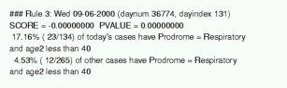
What’s Strange About Recent Events?
We can scan over subsets of the dataset in order to find those groups of records that correspond to a pattern.
Step 1: Compute score F(S, P) for each subset S = {x_{i}} and for each pattern type P, where higher score means more likely to be a pattern.
Step 2: Consider the highest scoring potential patterns (S, P) and decide whether each actually represents a pattern.
There are many options for computing the score of a subset S.
In the WSARE method (“What’s Strange About Recent Events”), we consider the subsets of the data defined by a one- or two-component rule R, and find rules where the current data is significantly different than the past.
For example, using WSARE for hospital Emergency Department surveillance resulted in finding the following significant rule, corresponding to an outbreak of respiratory illness on 9/6/2000.

Slide 34
Model-based pattern detection
We can scan over subsets of the dataset in order to find those groups of records that correspond to a pattern.
Step 1: Compute score F(S, P) for each subset S = {x_{i}} and for each pattern type P, where higher score means more likely to be a pattern.
Step 2: Consider the highest scoring potential patterns (S, P) and decide whether each actually represents a pattern.
There are many options for computing the score of a subset S.
In the model-based anomalous pattern detection approach, we model the effects of each pattern type P on the affected subset of the data S.
Now we create tables comparing the numbers of anomalous and normal records:
Anomalous
Normal
Compute p-value using a statistical test (C² or Fisher’s Exact). Lower p-value = higher score.
# records satisfying R
# records satisfying ~R
17
93
5
400
Notes:
That local anom can be anomaly detection method we have discussed. Inlcuding my favorite model based.
We can c. So to be an anomaly we can say if the probability of seeing this transaction given your historical behavior is < 0.01 we consider you an anomly.

Slide 35
Model-based pattern detection
We can scan over subsets of the dataset in order to find those groups of records that correspond to a pattern.
Step 1: Compute score F(S, P) for each subset S = {x_{i}} and for each pattern type P, where higher score means more likely to be a pattern.
Step 2: Consider the highest scoring potential patterns (S, P) and decide whether each actually represents a pattern.
There are many options for computing the score of a subset S.
In the model-based anomalous pattern detection approach, we model the effects of each pattern type P on the affected subset of the data S.
Commonly we compute the likelihood ratio statistic Pr(Data | H₁(S, P)) / Pr(Data | H₀) for each (S, P).
In event detection, we model the null hypothesis H₀ by estimating expected counts for each data stream assuming no events.
Each pattern P is assumed to increase the counts for some data streams in the affected set of spatial locations S.
Notes:
A more advanced technique is to compute the likelihood ratio

Slide 36
Which patterns to report?
We can scan over subsets of the dataset in order to find those groups of records that correspond to a pattern.
Step 1: Compute score F(S, P) for each subset S = {x_{i}} and for each pattern type P, where higher score means more likely to be a pattern.
Step 2: Consider the highest scoring potential patterns (S, P) and decide whether each actually represents a pattern.
Option 1: Report the k highest scoring subsets, ordered by score.
The disadvantage of this approach is that the user is not informed whether any of the discovered patterns are likely to be relevant.
However, this may be acceptable in monitoring systems or scientific discovery applications where the user is willing to evaluate a fixed number of potential patterns.

Slide 37
Which patterns to report?
We can scan over subsets of the dataset in order to find those groups of records that correspond to a pattern.
Step 1: Compute score F(S, P) for each subset S = {x_{i}} and for each pattern type P, where higher score means more likely to be a pattern.
Step 2: Consider the highest scoring potential patterns (S, P) and decide whether each actually represents a pattern.
Option 2: Perform hypothesis tests, and report all significant patterns (S, P).
In the hypothesis testing framework, we must adjust for the fact that we’re performing so many tests. Otherwise we will report too many false positives!
In model-based approaches, one way to do this is randomization: we generate a large number of simulated datasets assuming the null model, and compare the scores of the potential patterns in the real dataset to the highest scoring patterns in the simulated data.
An alternative is to adjust the p-value threshold for each test based on the number of tests performed (e.g. Bonferroni threshold = .05 / # tests)

Slide 38
Which patterns to report?
We can scan over subsets of the dataset in order to find those groups of records that correspond to a pattern.
Step 1: Compute score F(S, P) for each subset S = {x_{i}} and for each pattern type P, where higher score means more likely to be a pattern.
Step 2: Consider the highest scoring potential patterns (S, P) and decide whether each actually represents a pattern.
Option 3: Compute the posterior probability of each hypothesis H₁(S, P).
In a Bayesian framework, we must spread the prior probability of a pattern over all possible hypotheses H₁(S, P).
We then compute the likelihood of the data given each hypothesis H₁(S, P), as well as the null hypothesis of no patterns, H₀.
We can then compute the posterior probability of each hypothesis by Bayes’ Theorem:
Best for known pattern types!
Pr(H | D) = Pr(D | H) Pr(H) / Pr(D)
Option 2 better for anomalies!

Slide 39
Which Subsets to Scan?
Since there are exponentially many subsets of the data, it is often computationally infeasible to search all of them.
The most common approach is to use domain knowledge to restrict our search space: for example, in spatial cluster detection, we assume that a pattern will affect a spatially localized group of records, and often further restrict the cluster size and shape.
e.g. “search over circular regions centered at a data point” → only N² regions instead of 2^{N}.
Another common approach is to perform a greedy search. For example, we grow subsets starting from each record, repeatedly adding the additional record that gives the highest scoring subset.
Tradeoff: much more efficient than naïve search, but not guaranteed to find highest scoring region.
In some cases, we can find the highest-scoring subsets without actually computing the scores of all possible subsets!
Notes:
- Intervals or circular regions (in time or space). For any subset, you can do any of the things we talked about before.

Slide 40
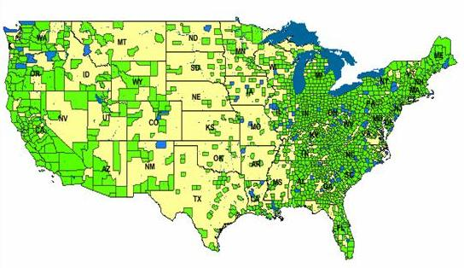
Linear-time subset scanning
Given a score function F(S) which satisfies the linear-time subset scanning property, we can optimize F(S) over the exponentially many subsets of data records, while evaluating only O(N) regions instead of O(2^{N}).
Just sort the locations from highest to lowest priority according to some function, then search over groups consisting of the top-k highest priority locations (k = 1..N). The highest scoring subset will be one of these!
Many useful score functions satisfy the LTSS property. In the spatial cluster detection setting, we can efficiently optimize a spatial scan statistic over subsets of locations to find the most interesting spatial region.
This works both for univariate data, monitoring a single data stream across time and space, and multivariate data, monitoring multiple data streams.
We can also incorporate relevant constraints such as spatial proximity, temporal consistency, or graph connectivity into the detection process.

Slide 41
Linear-time subset scanning
Given a score function F(S) which satisfies the linear-time subset scanning property, we can optimize F(S) over the exponentially many subsets of data records, while evaluating only O(N) regions instead of O(2^{N}).
Just sort the locations from highest to lowest priority according to some function, then search over groups consisting of the top-k highest priority locations (k = 1..N). The highest scoring subset will be one of these!
Many useful score functions satisfy the LTSS property. In the spatial cluster detection setting, we can efficiently optimize a spatial scan statistic over subsets of locations to find the most interesting spatial region.
This works both for univariate data, monitoring a single data stream across time and space, and multivariate data, monitoring multiple data streams.
LTSS allows us to solve problems in milliseconds that would previously have required hundreds of millions of years!

Slide 42
References
A coherent text on anomalous pattern detection has yet to be written, but many methods have been proposed and are becoming common:
WSARE: W.-K. Wong et al., “Rule-based anomaly pattern detection for detecting disease outbreaks,” Proc. 18th Natl. Conf. on Artificial Intelligence, 2002.
APD (“Anomaly Pattern Detection”). K. Das, J. Schneider, and D.B. Neill, Proc. KDD 2008.
D.B. Neill and W.-K. Wong, “A Tutorial on Event Detection,” presented at KDD 2009 conference.
Edward McFowland III, Skyler Speakman, and Daniel B. Neill. Fast generalized subset scan for anomalous pattern detection. Journal of Machine Learning Research, 14: 1533-1561, 2013.
Software for spatial cluster detection and for WSARE is available on the Auton Laboratory web page, http://www.autonlab.org.

